Slide 1
EMPLOYEE MANAGEMENT SYSTEM
Under the guidance of By AMIRTHA S
Jetashree Shirodkar MARIYAN JONES N
VINOTHA M
VISHNUGAYATHRI R

Slide 2
ABSTRACT
In this era of technological developments, people tend to use more sophisticated data management with good performance .
Web Pages are the face of the Internet, which helps users to access the information across the Internet.
One of the famous stacks which is put to usage for decades is the JEE of Java and Spring with Spring Boot.
Therefore these latest technologies named Spring Boot and Angular are playing a very prominent role in managing the data.
Sprint Boot is considered as a light-weight framework and helps in retrieving and storing the data with less complexity.
Our model helps in managing employees data in a database with SPRING BOOT as backend and ANGULAR as front end.

Slide 3
INTRODUCTION
Our Project (Employee Management System using spring boot and Angular) is an implementation of a web application using Spring with Spring Boot as Backend and Angular with router as Frontend. Angular is one of the most popular libraries for the front-end development.
Angular uses components rendering over a single web page. Axiosis the bridge with closes the gap between the Spring Framework and Angular Library, Making it a robust Web Application.
This project takes users’ information through the web page on the react and passes that information through the Axios to the backend which in-turn places the information in the database called derby, Apache Derby was used along with JDBC integration as a Database.
This Process can be implemented with any other SQL Database as well. Therefore Employees data can be maintained with the operations like add, edit, view and delete using flexible home page

Slide 4
PROJECT OVERVIEW
To develop a CRUD full stack web application that is basic Employee Management Application using Angular and Spring Boot.
To develop CRUD features
Create Employee
List Employee
Update Employee
Delete Employee
View Employee

Slide 5
Tools and technologies used
Server-side technologies
Spring Boot - 2.0.5.RELEASE
JDK - 1.8 or later
Spring Framework - 5.0.8 RELEASE
Hibernate - 5.2.17.Final
Spring Data JPA - 2+
Database
MySQL database

Slide 6
Front end technologies
Angular 10
Bootstrap 4
npm- 6.9.0
JQuery
Node js 10+
Tools
Maven - 3.2+
IDE - Eclipse or Spring Tool Suite (STS) // Spring boot API development
Visual Studio // Angular App development
Angular CLI 10

Slide 7
OVERVIEW OF ANGULAR
Angular is a platform and framework for building single page client applications using HTML and TypeScript.
Angular is written in TypeScript.
Great for Single page applications.
Angular is modular in nature.
Built-in features DI, data binding etc

Slide 8
OVERVIEW OF SPRING BOOT
Spring boot to develop REST web services and microservices.
Spring Boot has taken Spring framework to next level.
It has drastically reduced the configuration and setup time required for spring projects.
That can setup a project with almost zero configuration and start building the things that actually matter to an application.

Slide 9

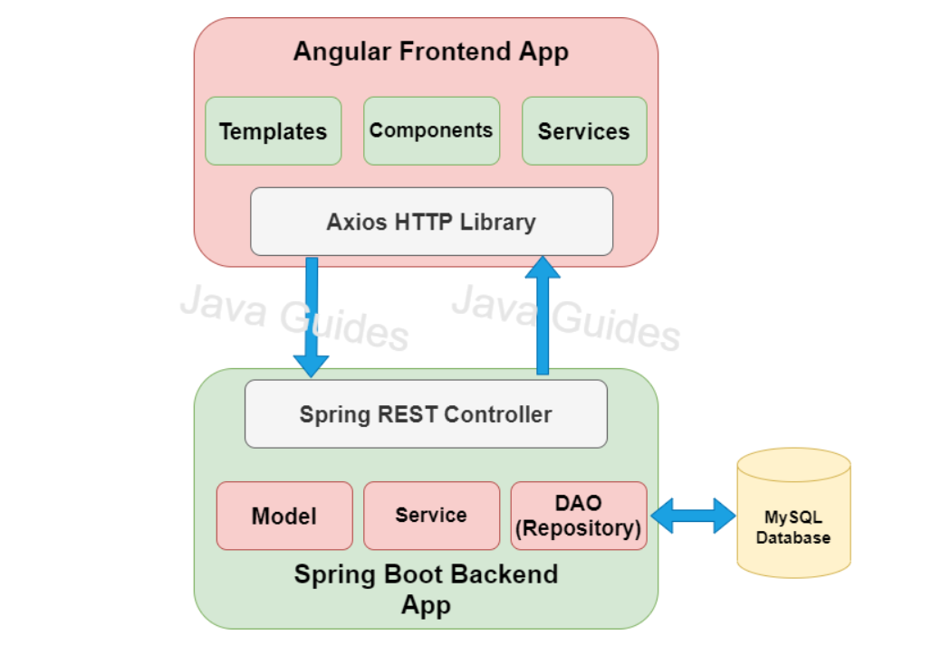
CLIENT SERVER ARCHITECTURE

Slide 10
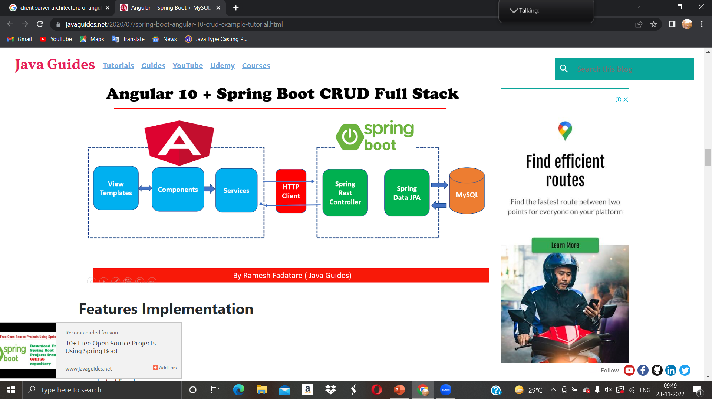
AUGULAR + SPRING BOOT CRUD FULL STACK

Slide 11
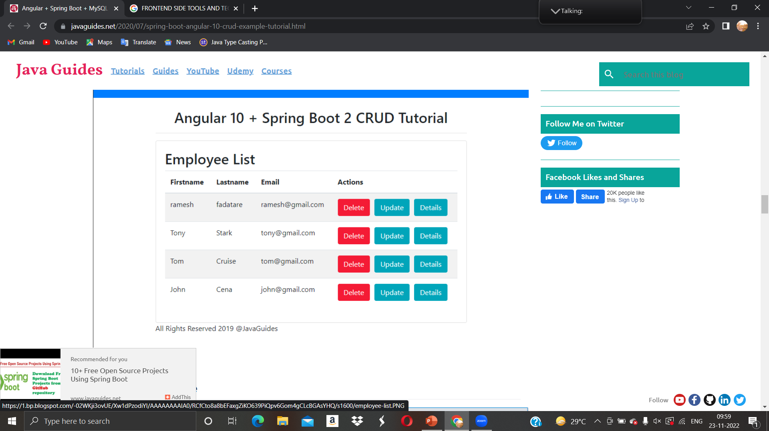
EMPLOYEE LIST PAGE

Slide 12
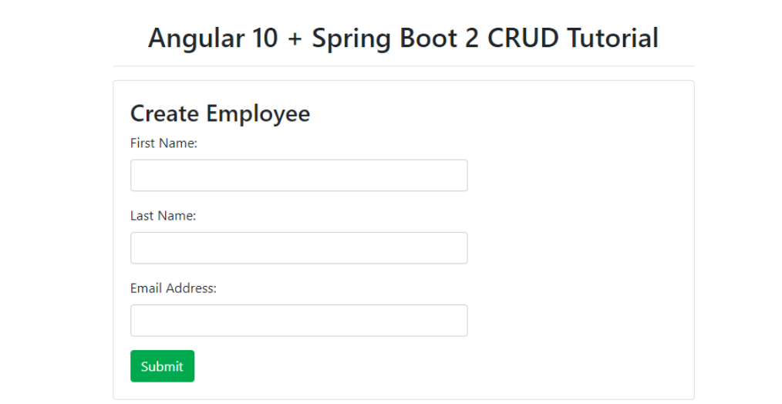
Add Employee Page

Slide 13
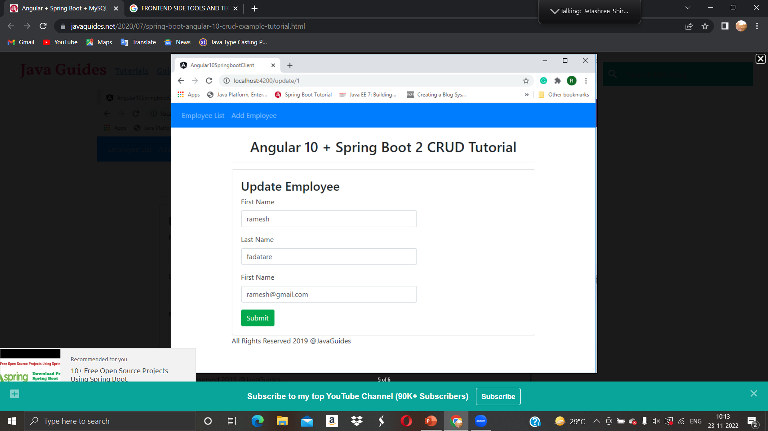
Update Employee Page

Slide 14
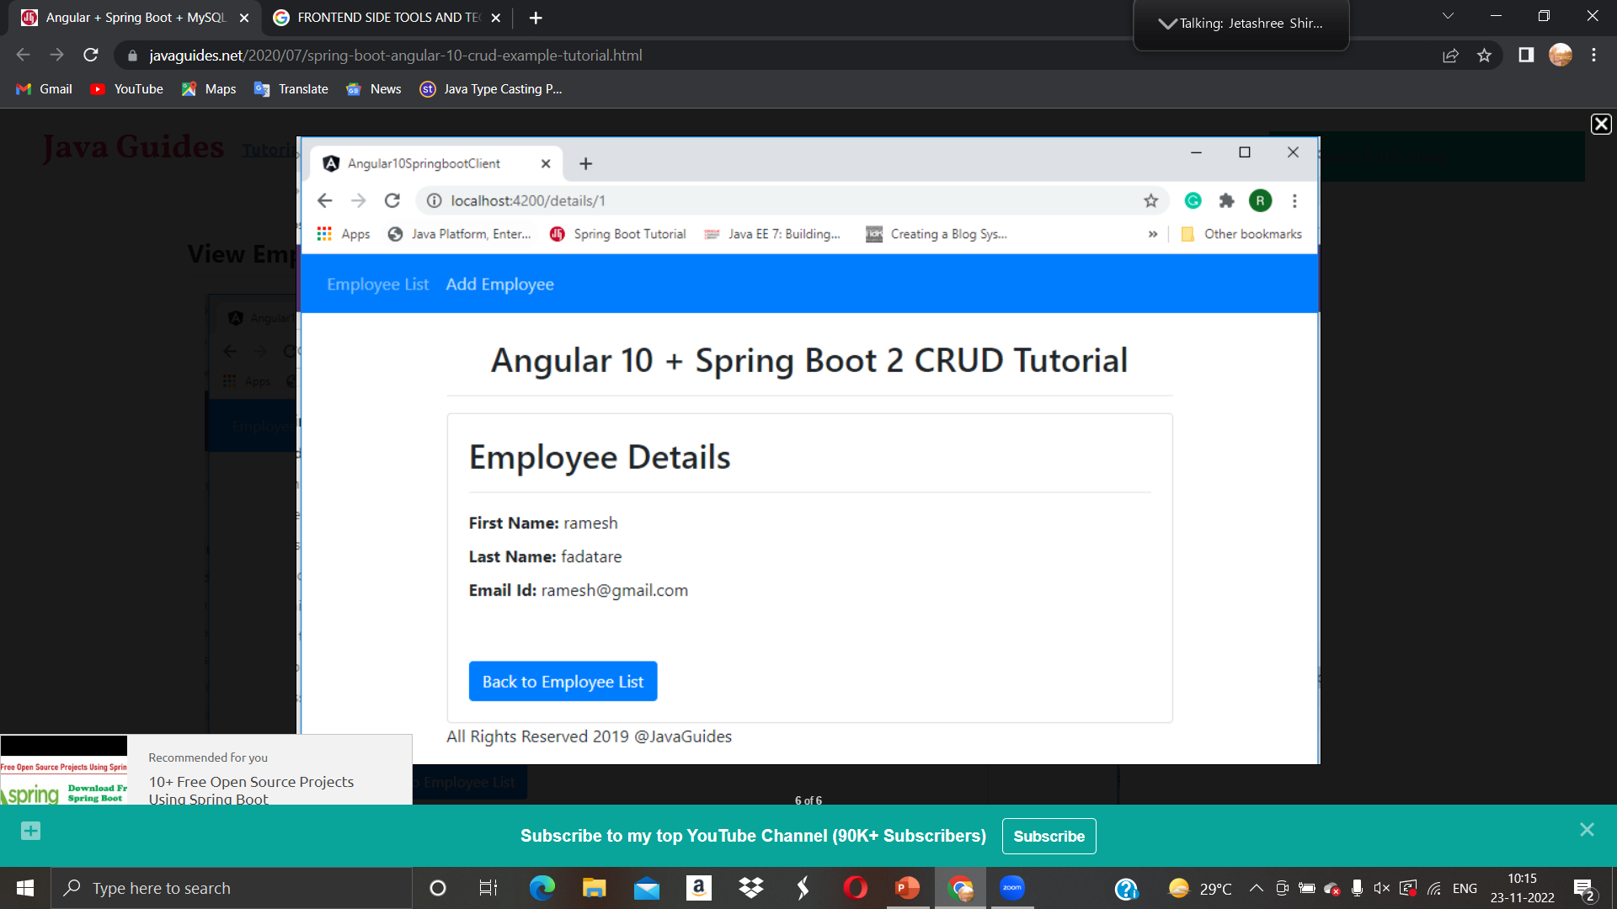
View Employee Details Page

Slide 15
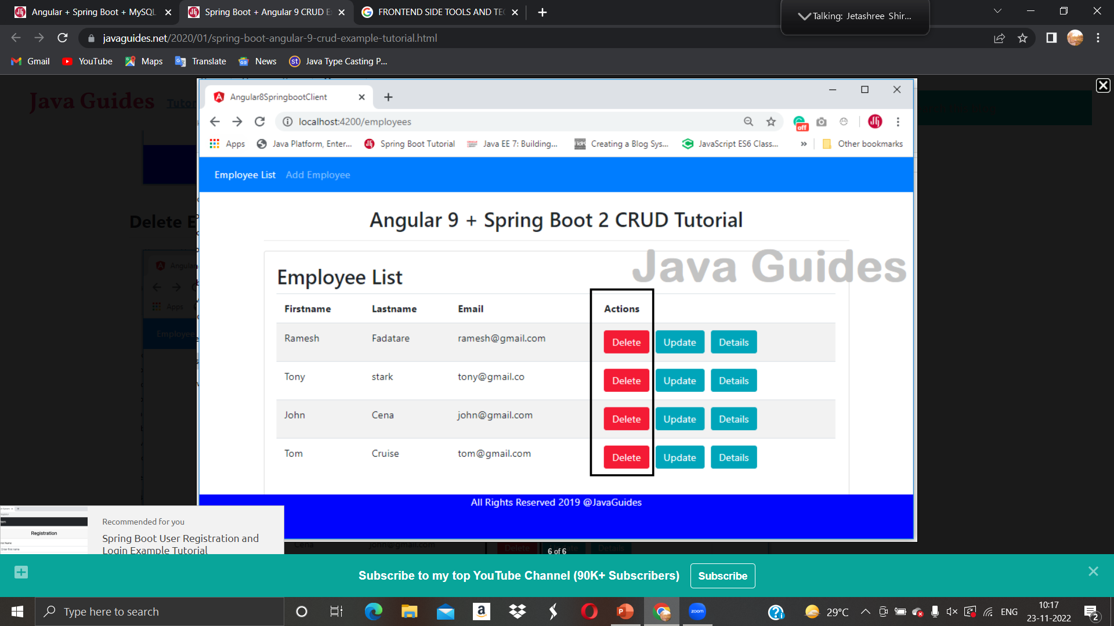
Delete Employee

Slide 16
THANK YOU

